Slide 1
Chapter 10
One- and Two-Sample Tests of Hypotheses

Slide 2
Section 10.1
Statistical Hypotheses: General Concepts

Slide 3
Definition 10.1

Slide 4
Section 10.2
Testing a Statistical Hypothesis

Slide 5
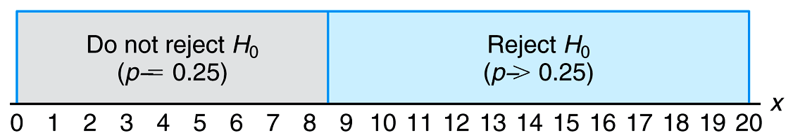
Figure 10.1 Decision criterion for testing p = 0.25 versus p > 0.25

Slide 6
Definition 10.2

Slide 7
Definition 10.3

Slide 8
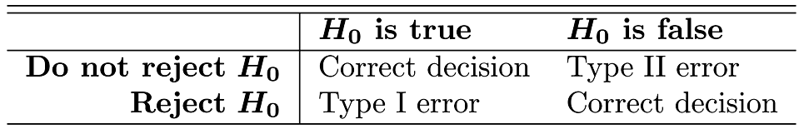
Table 10.1 Possible Situations for Testing a Statistical Hypothesis

Slide 9
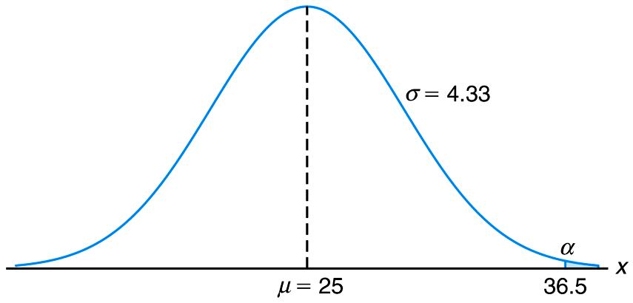
Figure 10.2 Probability of a type I error

Slide 10
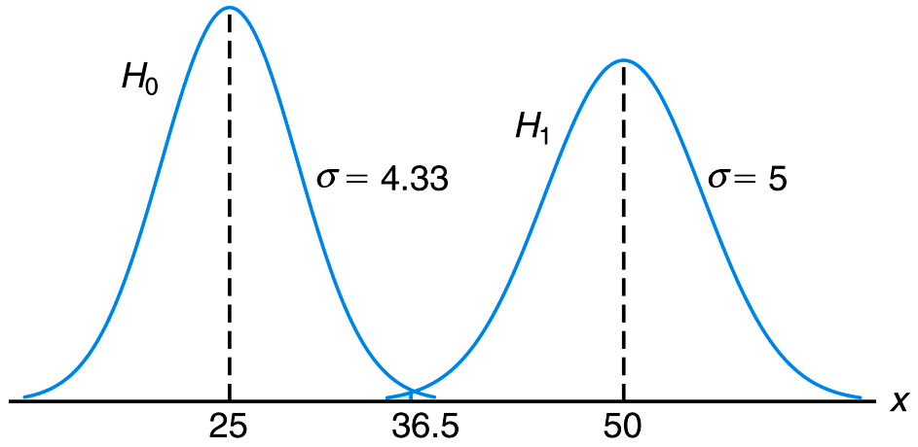
Figure 10.3 Probability of a type II error

Slide 11
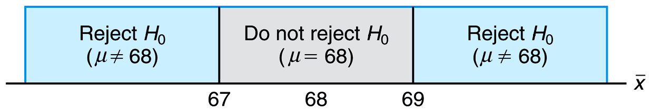
Figure 10.4 Critical region (in blue)

Slide 12

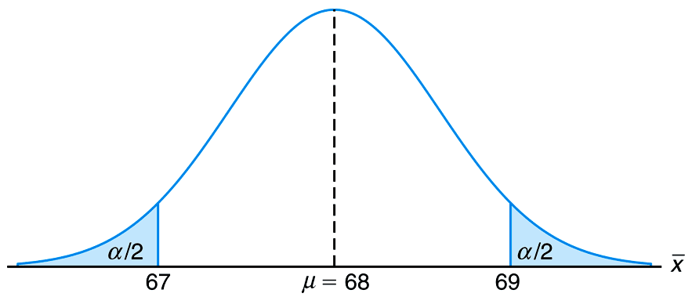
Figure 10.5 Critical Region for testing μ = 68 versus μ 68

Slide 13
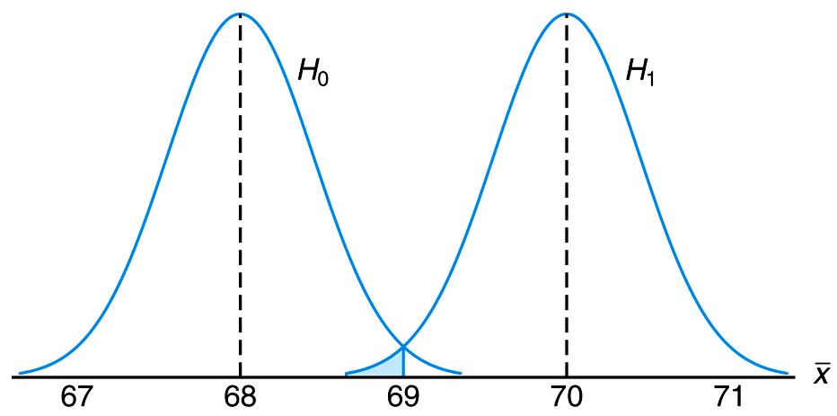
Figure 10.6 Probability of type II error for testing μ = 68 versus μ = 70

Slide 14
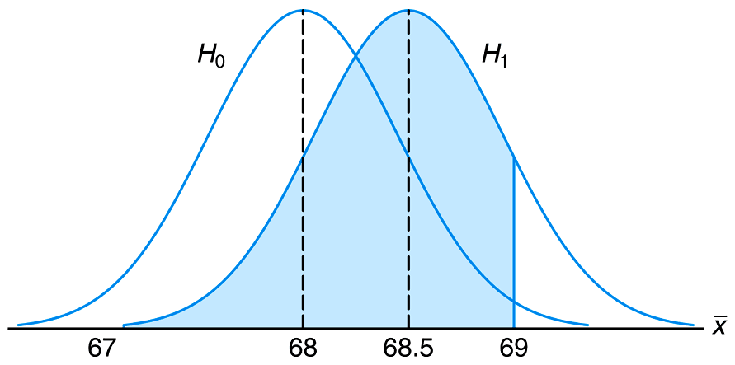
Figure 10.7 Type II error for testing μ = 68 versus μ = 68.5

Slide 15
Definition 10.4

Slide 16
Section 10.3
The Use of P-Values for Decision Making in Testing Hypotheses

Slide 17
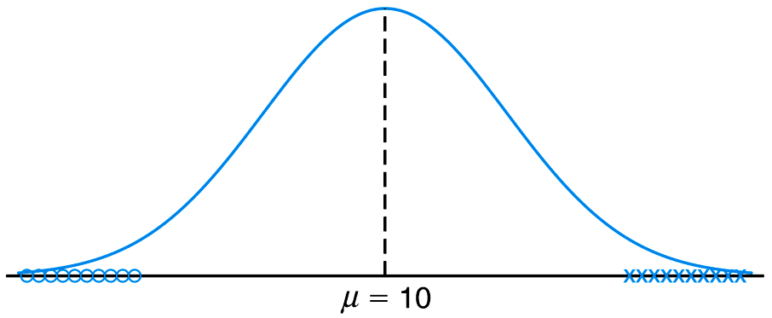
Figure 10.8 Data that are likely generated from populations having two different means

Slide 18
Definition 10.5

Slide 19
Section 10.4
Single Sample: Tests Concerning a Single Mean

Slide 20
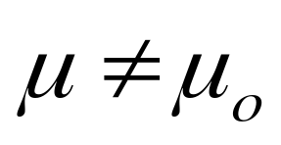
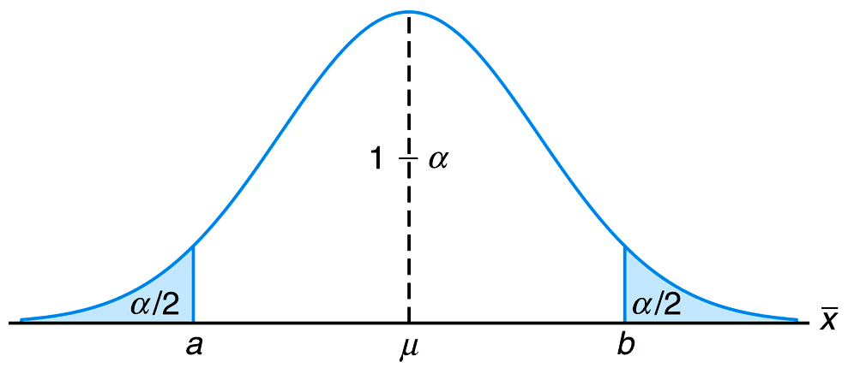
Figure 10.9 Critical region for the alternative hypothesis

Slide 21
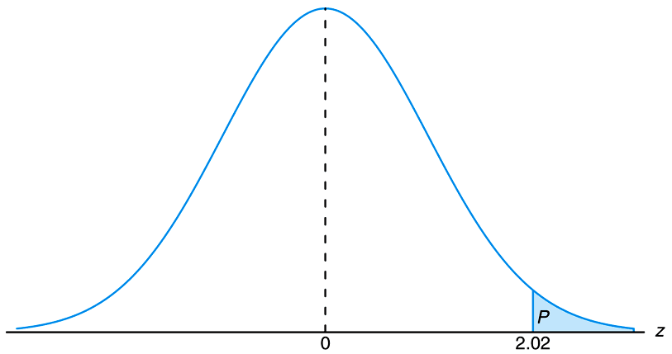
Figure 10.10 P-value for Example 10.3

Slide 22
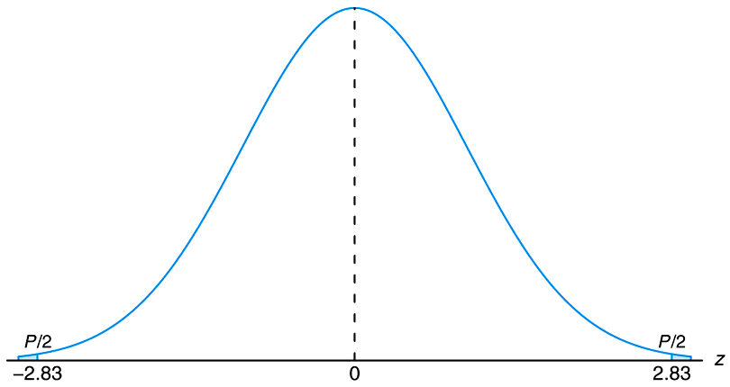
Figure 10.11 P-value for Example 10.4

Slide 23
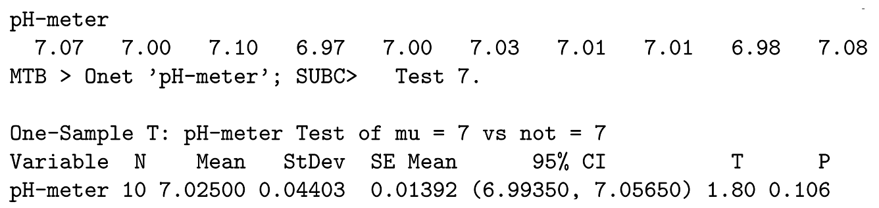
Figure 10.12 MINITAB printout for one sample t-test for pH meter

Slide 24
Section 10.5
Two Samples: Tests on Two Means

Slide 25
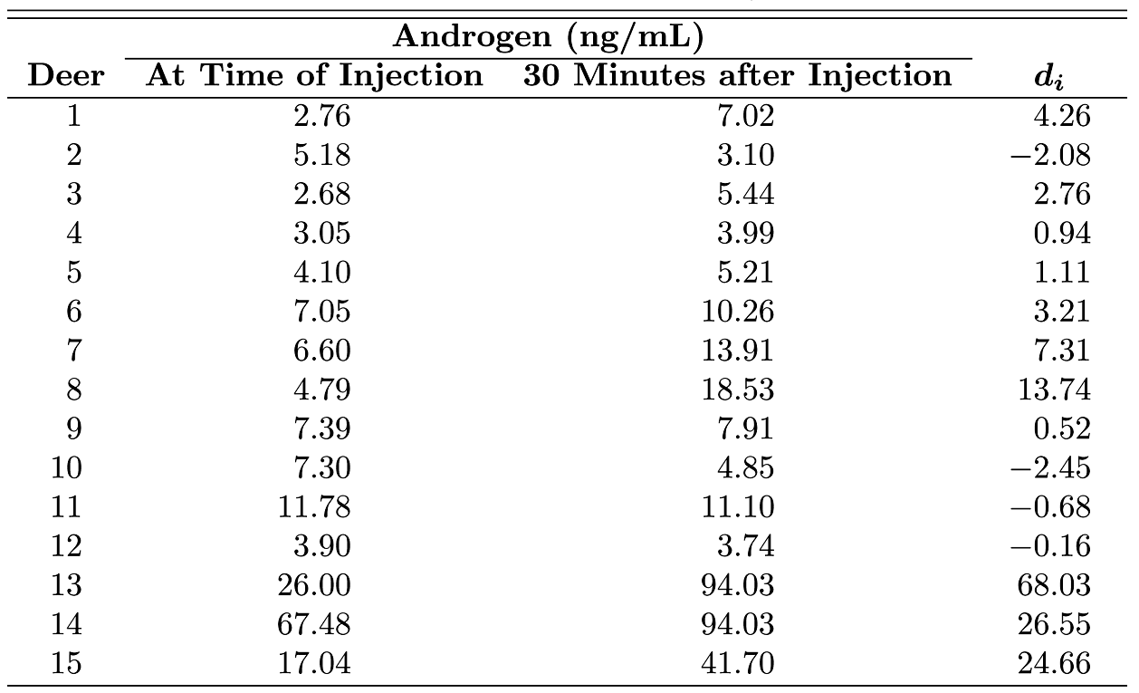
Table 10.2 Data for Case Study 10.1

Slide 26
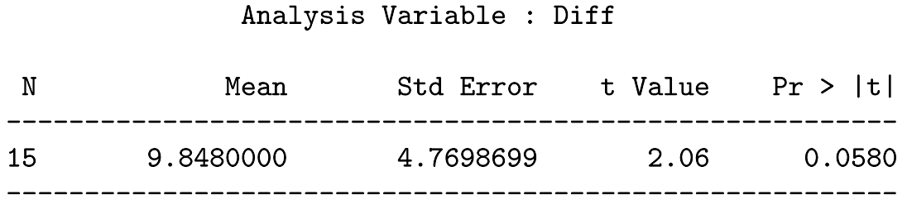
Figure 10.13 SAS printout of paired t-test for data of Case Study 10.1

Slide 27
Section 10.6
Choice of Sample Size for Testing Means

Slide 28
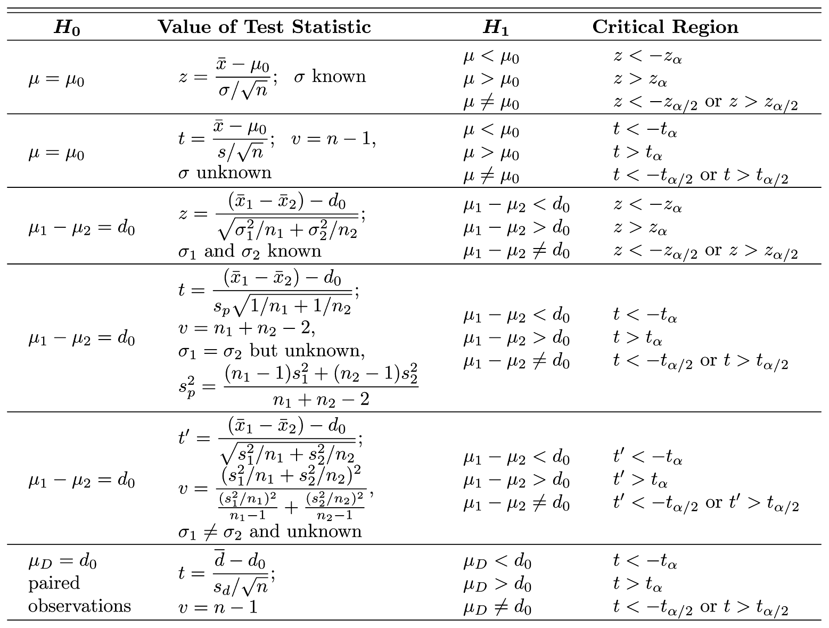
Table 10.3 Tests Concerning Means

Slide 29
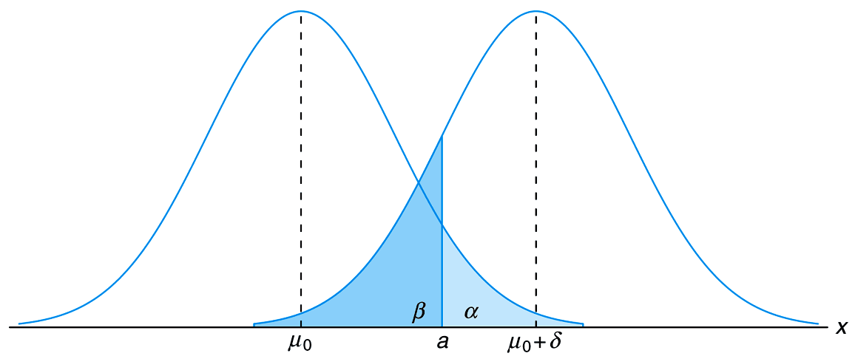
Figure 10.14 Testing μ = μ_{o} versus μ = μ_{o} + δ

Slide 30
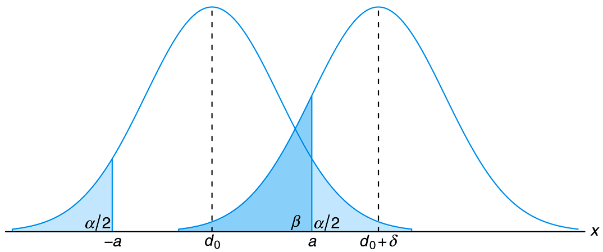
Figure 10.15 Testing μ₁−μ₂ = d_{o} versus μ₁−μ₂ = d_{ο} + δ

Slide 31
Section 10.7
Graphical Methods for Comparing Means

Slide 32
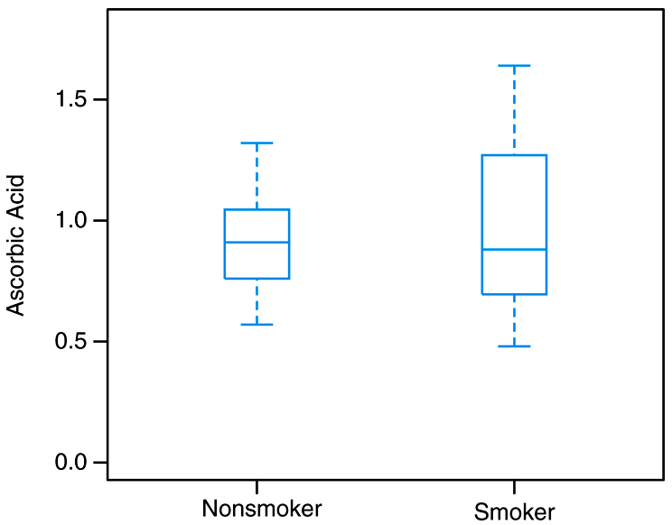
Figure 10.16 Two box-and whisker plots of plasma ascorbic acid in smokers and nonsmokers

Slide 33
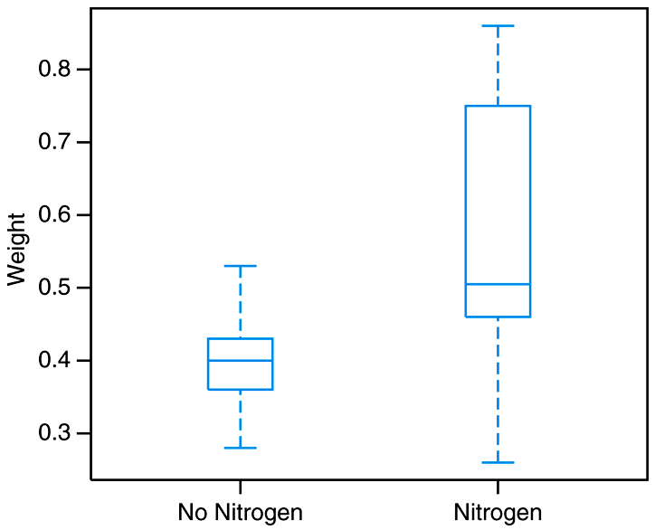
Figure 10.17 Two box-and-whisker plots of seedling data

Slide 34
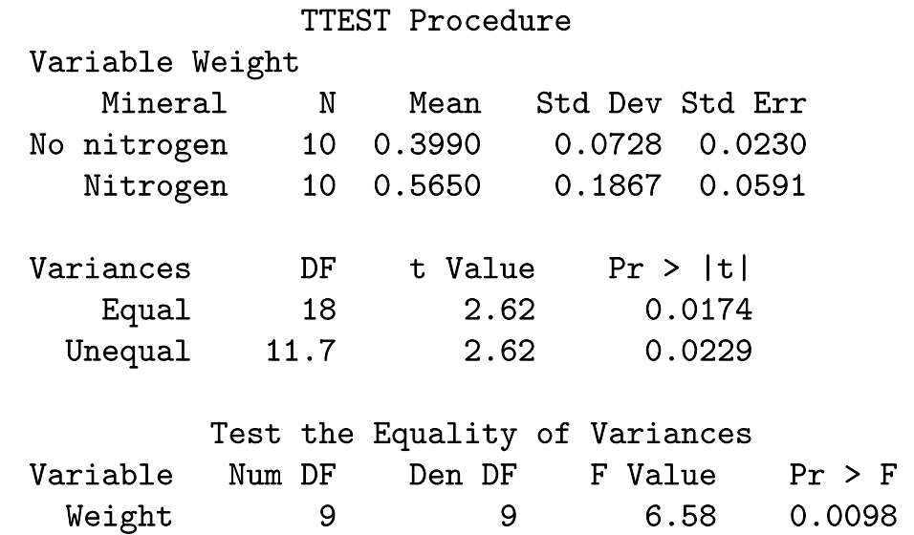
Figure 10.18 SAS printout for two-sample t-test

Slide 35
Section 10.8
One Sample: Test on a Single Proportion

Slide 36
Section 10.9
Two Samples: Tests on Two Proportions

Slide 37
Section 10.10
One- and Two- Sample Tests Concerning Variances

Slide 38
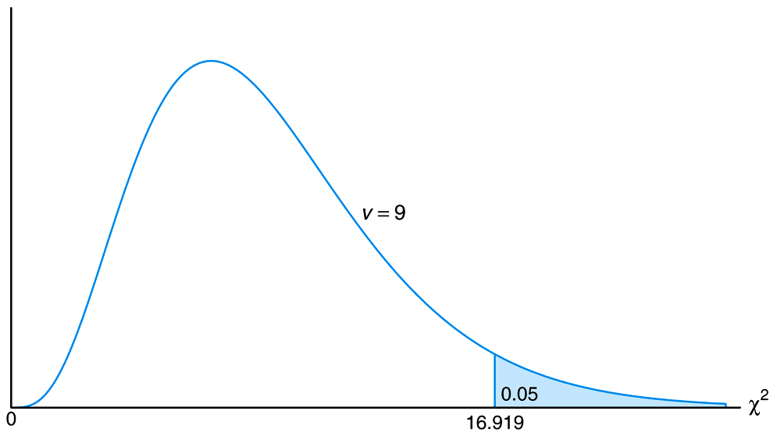
Figure 10.19 Critical region for the alternative hypothesis σ > 0.9

Slide 39
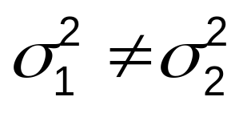
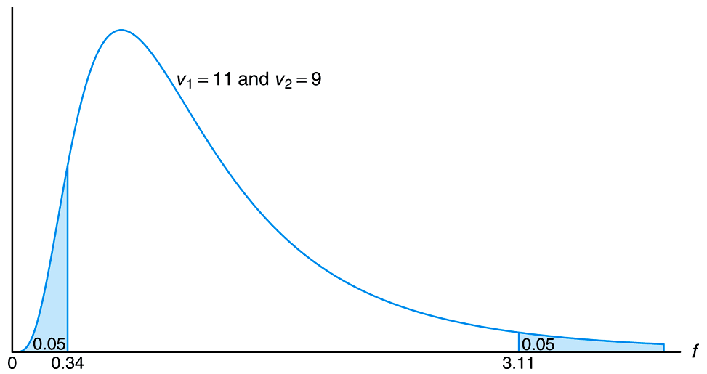
Figure 10.20 Critical region for the alternative hypothesis

Slide 40
Section 10.11
Goodness-of-Fit Test

Slide 41
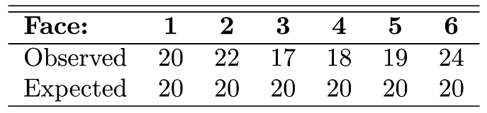
Table 10.4 Observed and Expected Frequencies of 120 Tosses of a Die

Slide 42
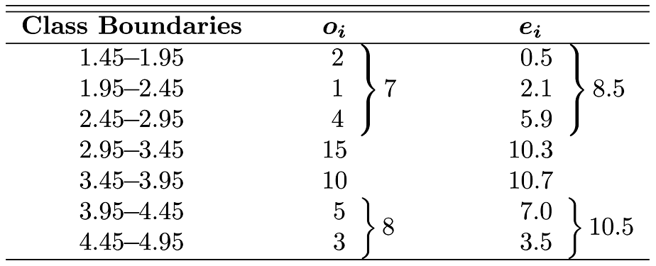
Table 10.5 Observed and Expected Frequencies of Battery Lives, Assuming Normality

Slide 43
Section 10.12
Test for Independence (Categorical Data)

Slide 44

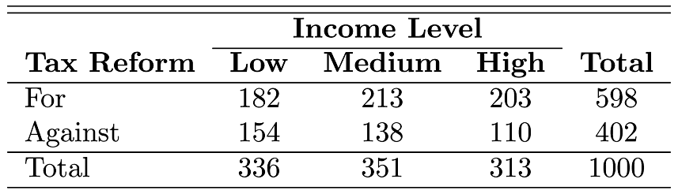
Table 10.6 2 3 Contingency Table

Slide 45
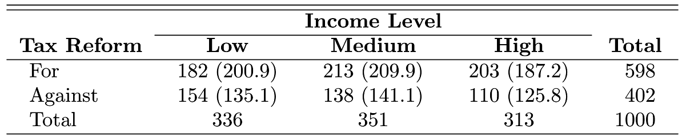
Table 10.7 Observes and Expected Frequencies

Slide 46
Section 10.13
Test for Homogeneity

Slide 47
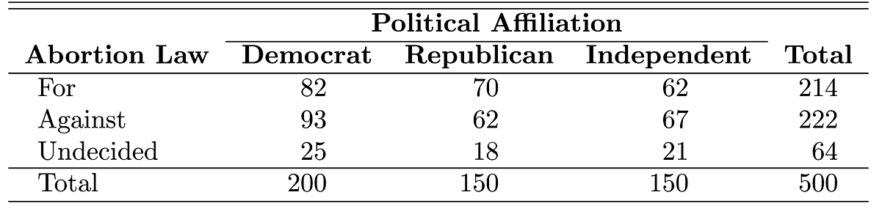
Table 10.8 Observed Frequencies

Slide 48
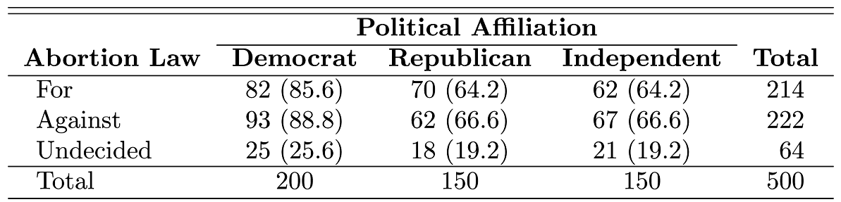
Table 10.9 Observed and Expected Frequencies

Slide 49
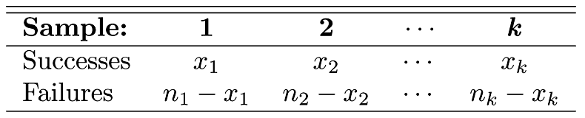
Table 10.10 k Independent Binomial Samples

Slide 50
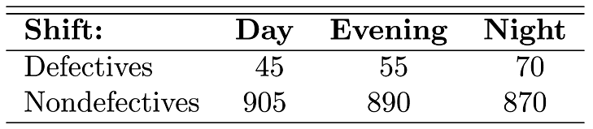
Table 10.11 Data for Example 10.15

Slide 51
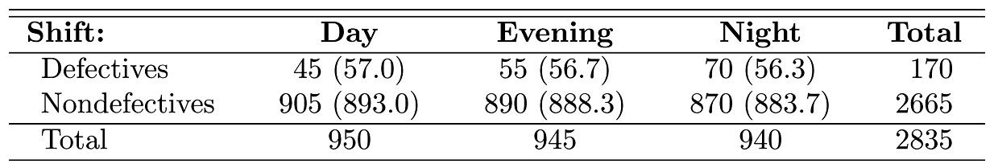
Table 10.12 Observed and Expected Frequencies

Slide 52
Section 10.14
Two-Sample Case Study

Slide 53
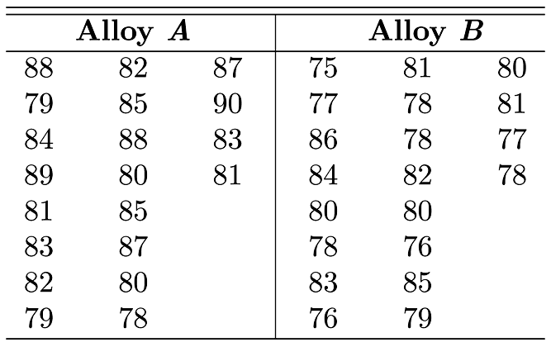
Table 10.13 Data for Two-Sample Case Study

Slide 54
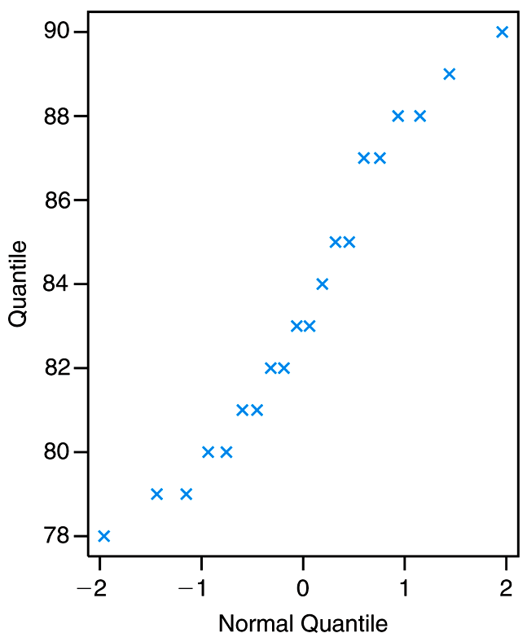
Figure 10.21 Normal quantile-quantile plot of data for alloy A

Slide 55
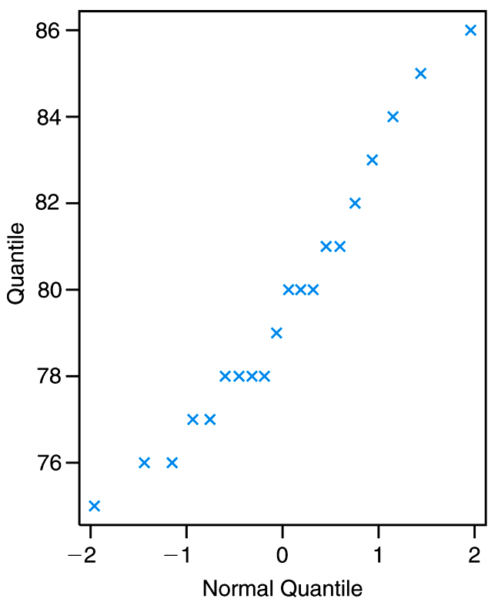
Figure 10.22 Normal quantile-quantile plot of data for alloy B

Slide 56
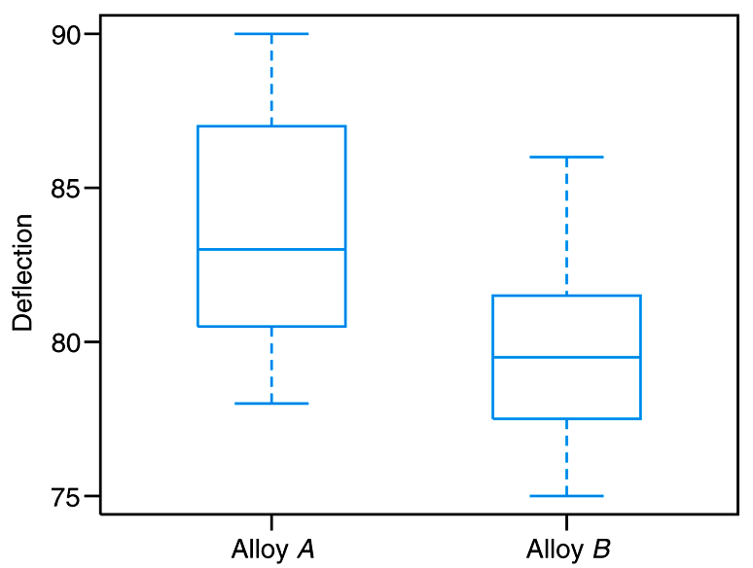
Figure 10.23 Box-and-whisker plots for both alloys

Slide 57
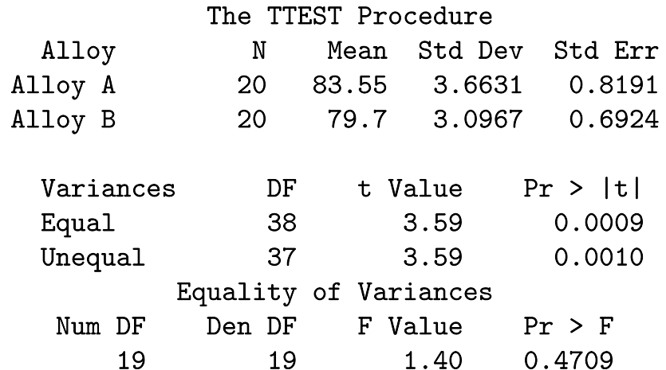
Figure 10.24 Annotated SAS printout for alloy data

Slide 58
Section 10.15
Potential Misconceptions and Hazards; Relationship to Material in Other Chapters

